Slide 1
KeyCard – Dongle for KeysightCare
Support. Elevated.
Romansapien M
Kuifeng Clifford Hu
SEPT 2018
Notes:
Hello and welcome.
Introduce self.
Today we are going to talk about KeysightCare and how this elevated level of support can help you bring your products to market faster.

Slide 2

KeyCard
- Keysight Care Support

Slide 3
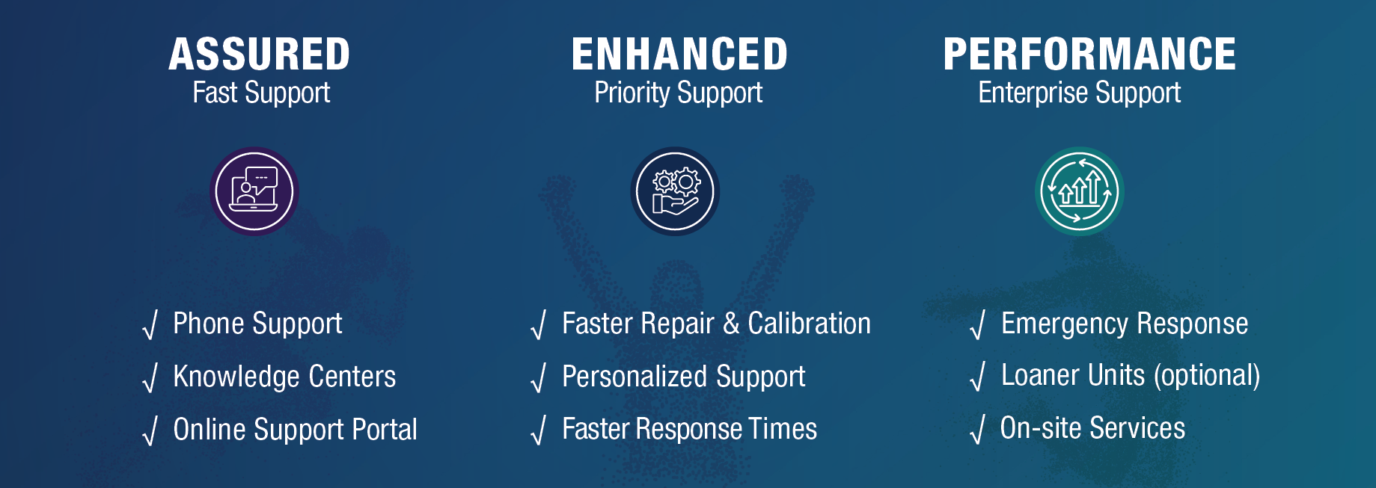
Keycard can help to address the following goals
Notes:
Go beyond basic warranty with the level of KeysightCare that matches your business needs

Slide 4
What is a KeyCard
Wifi enabled dongle with display
Product information
Product info/
Support contacts
Everyday Tips from Knowledge Center
Available Services
Calibration
Calibration history
Firmware upgrade reminder
Calibration Due date reminder
Notification
Promotion Twits
Community Hot Topics
Instant message

Slide 5
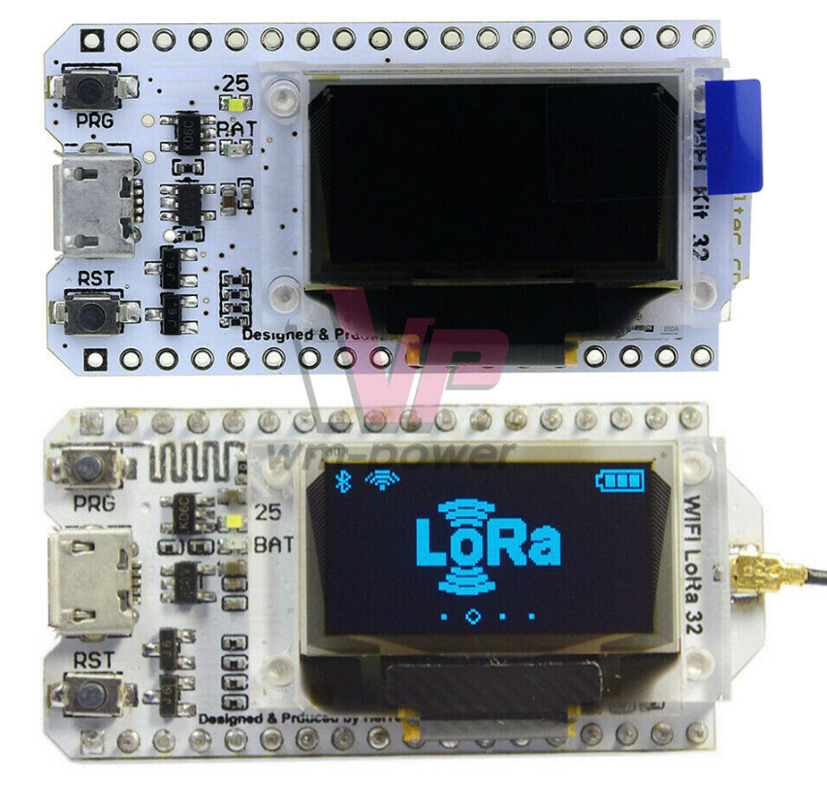
Implementation
LoRa ESP32 SX1276/SX1278 0.96 inch OLED WIFI Bluetooth CP2102 Module for Arduino
Hardware Cost <$10.00

